Slide 1
What is the Forest Stewardship Council?

Slide 2
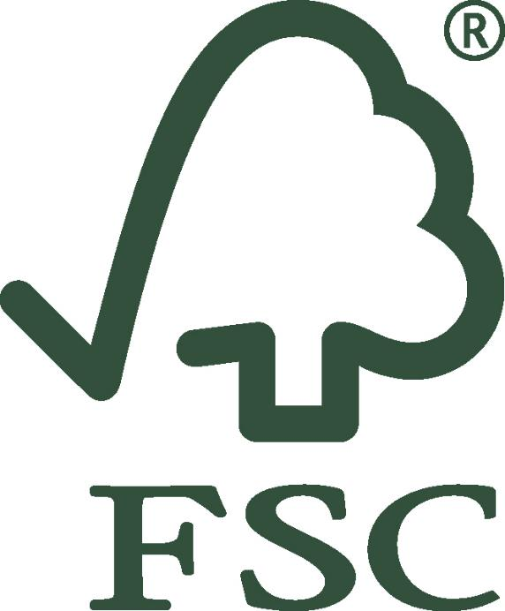
Have you seen this logo?
Where have you seen it?
Do you know what it means?
Notes:
This logo belongs to the Forest Stewardship Council, also known as FSC.
You might have seen the logo on things like boxes of food, packets of toilet roll or wooden furniture.

Slide 3
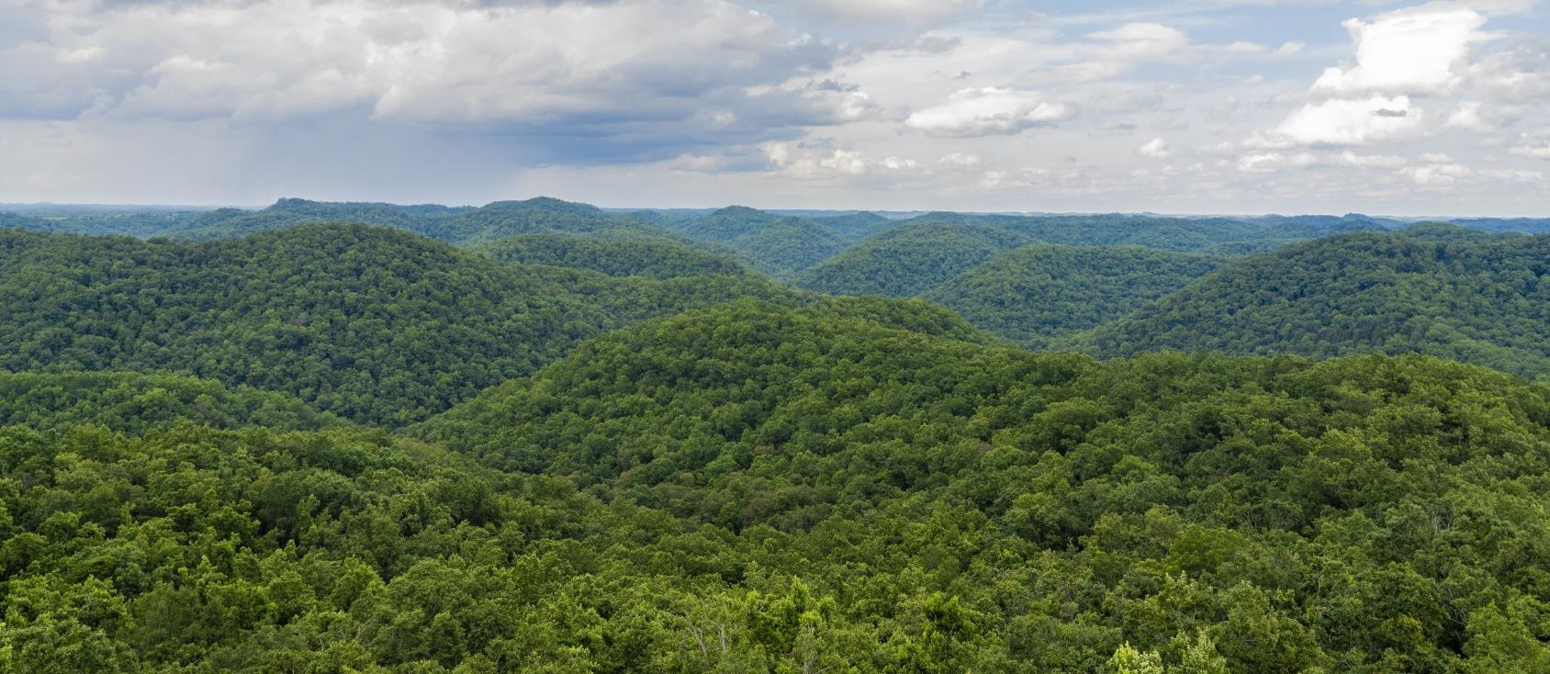
Forest Stewardship Council
FSC-certified forest in Appalachia, USA ©FSC / Julián Manrique
Notes:
The Forest Stewardship Council is an organisation that works in lots of different countries around the world to protect forests.

Slide 4
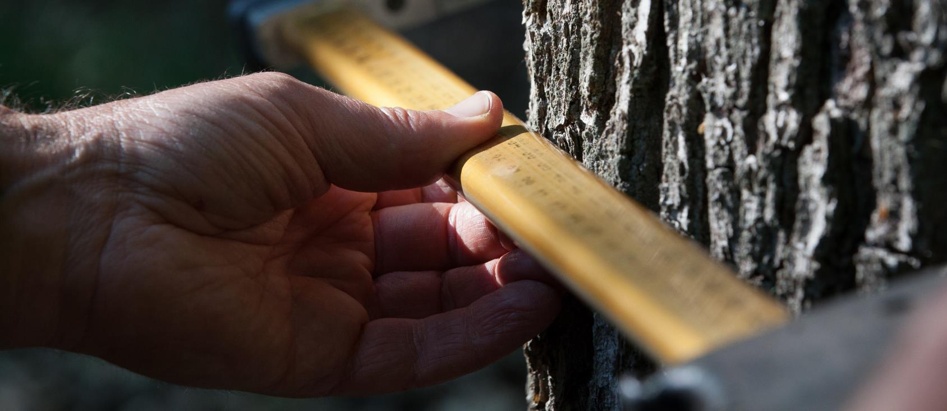
Forest stewardship Council
Measuring a tree in an FSC-certified forest ©FSC Germany / Stefan Lechner
Notes:
Stewardship means supervising or taking care of something. FSC takes care of forests by making rules for the people who look after forests, and other businesses, to follow.

Slide 5
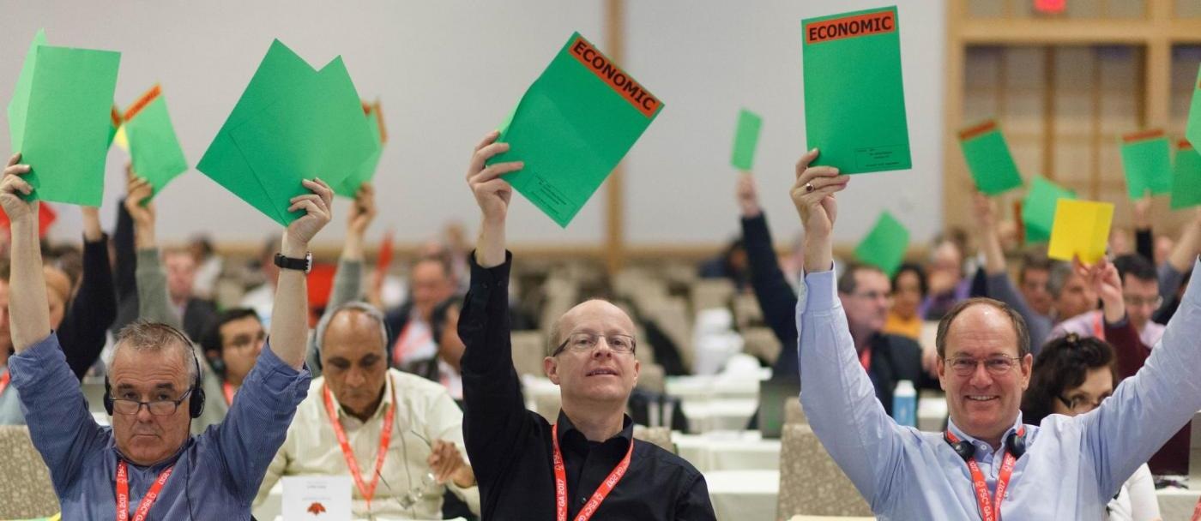
Forest Stewardship Council
Members voting at the FSC General Assembly ©FSC AC / Geoff Howe
Notes:
FSC is run by members. These are organizations and individual people who come up with ideas about what FSC should do and how it should be done. They vote to decide on which ideas FSC should focus.

Slide 6
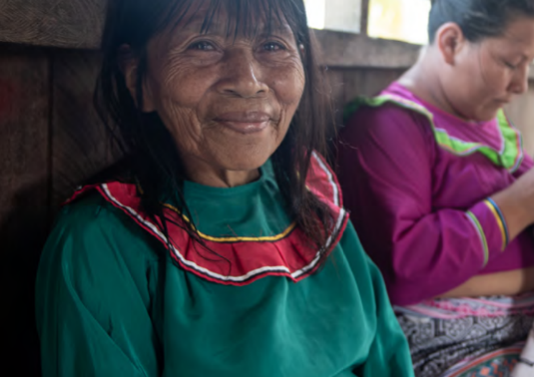
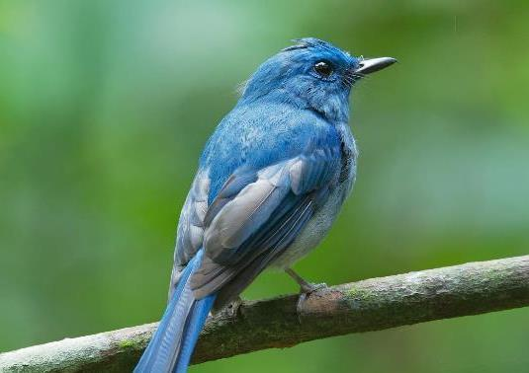
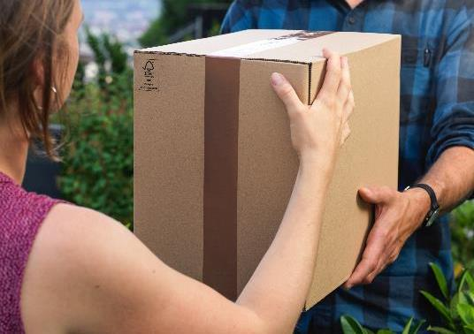
FSC members
1/3
Social
1/3
Environmental
1/3
Economic
Representing the views of people, such as workers and Indigenous Peoples
Representing views about the environment
Representing the views of businesses
Notes:
When a member joins FSC they are put into one of three groups: social, environmental or economic. Which group they are in will depend on what kind of views they represent. When the members vote on a topic, each group gets an equal share of the vote so that decisions are balanced between the needs of people, the environment and businesses. We’ll learn more about why forests are important for these different groups in the next sections.

Slide 7
Why are forests important?

Slide 8
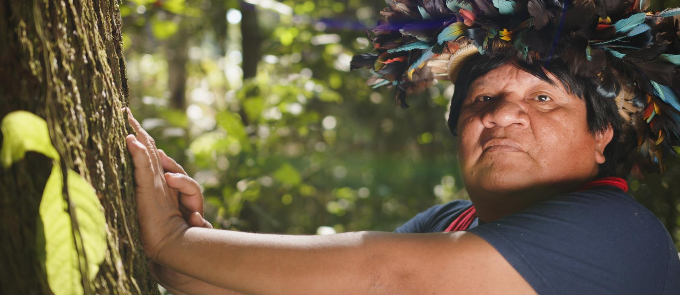
People
Member of the Paiter Suruí Indigenous People, Brazil ©FSC Brazil / Célio Cavalcante Filho
Notes:
Have you ever spent time in a forest?
Lots of different people live, work and play in forests around the world.
Some forests are home to Indigenous Peoples, the first people known to have lived in an area. There are more than 5000 groups of Indigenous Peoples are the world, speaking around 4000 different languages. Indigenous Peoples often have a close connection with their environment.

Slide 9
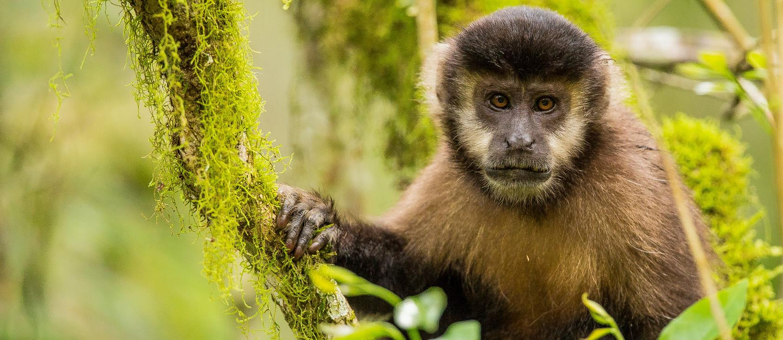
Plants and animals
FSC-certified Arauco Missionary Forest, Argentina ©FSC / Emilio White
Notes:
80% the plants and animals that live on land, live in forests.
What plants or animals do you know that live in forests?

Slide 10
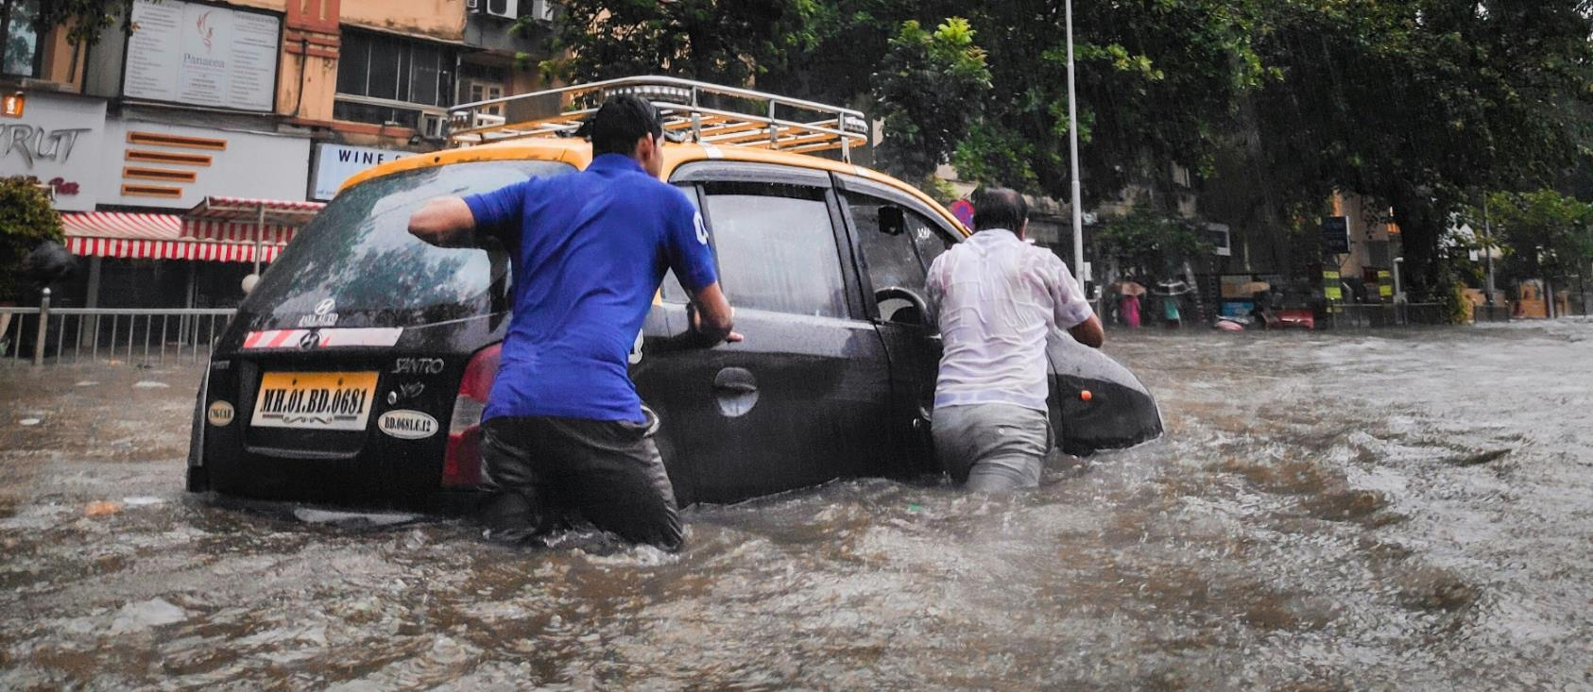
Water and soil
© Saikiran Kesari via Unsplsh
Notes:
Forests help to prevent flooding and stop soil being washed away. Flooding and landslides can put people and animals in danger.

Slide 11
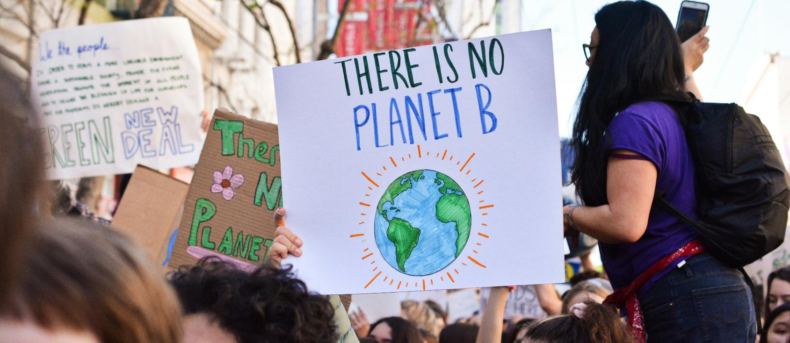
Climate
©Li an Lim via Unsplash
Notes:
Trees and plants in forests absorb harmful gasses which cause climate change.

Slide 12
Why use wood?

Slide 13
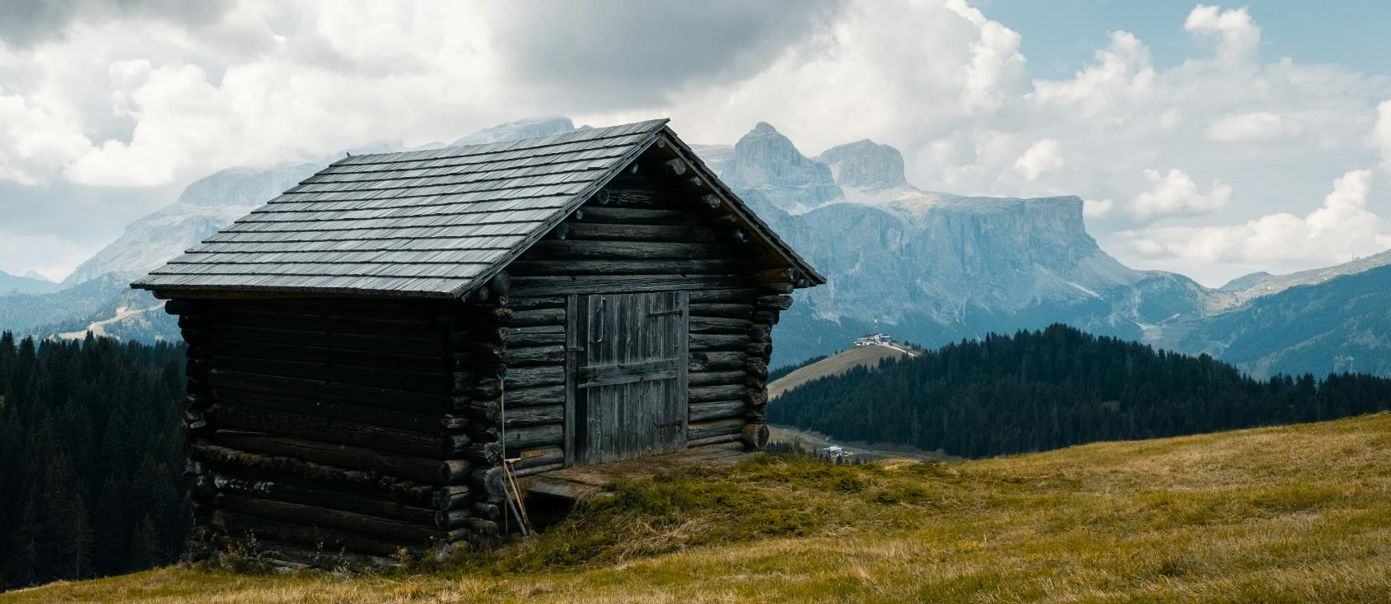
History
©Michele Tardivo via Unsplash
Notes:
Wood is one of the oldest building materials in existence. Humans have used it to make tools, buildings and more for thousands of years.

Slide 14
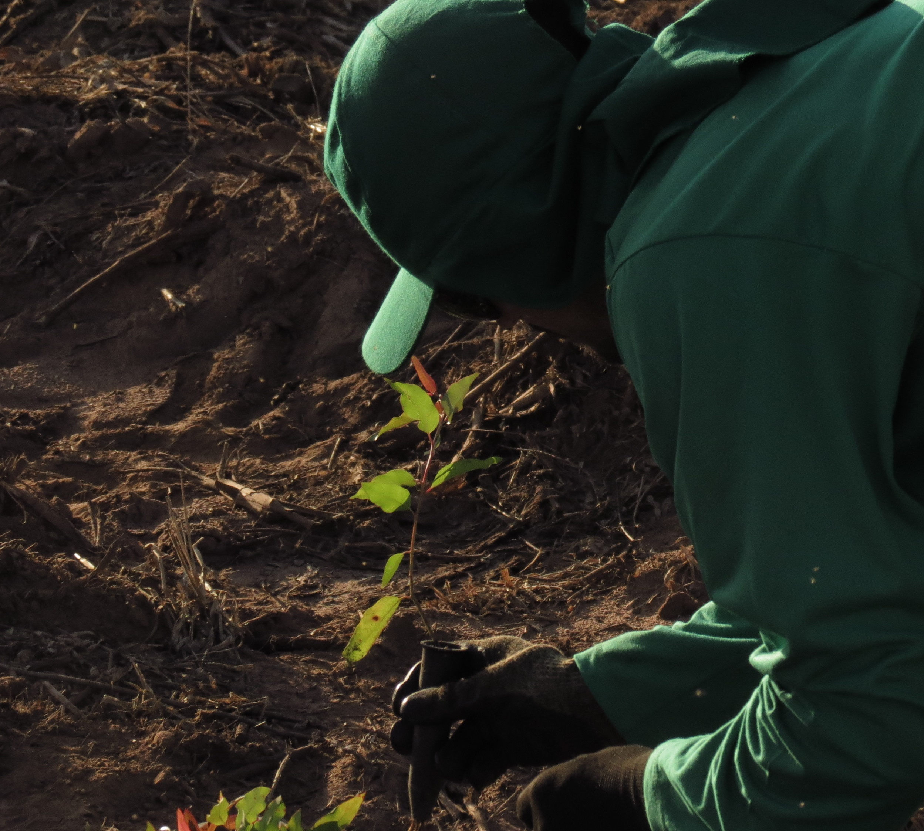
Benefits
Renewable (can be grown again and again)
Recyclable
Uses less energy to make than concrete, cement, bricks or steel
Can replace plastic (which is made from oil) in lots of situations
©FSC Brazil
Notes:
Wood is renewable, meaning it can be grown and harvested again and again. It can also be recycled. Wood can be used instead of less sustainable materials such as concrete and plastic.

Slide 15
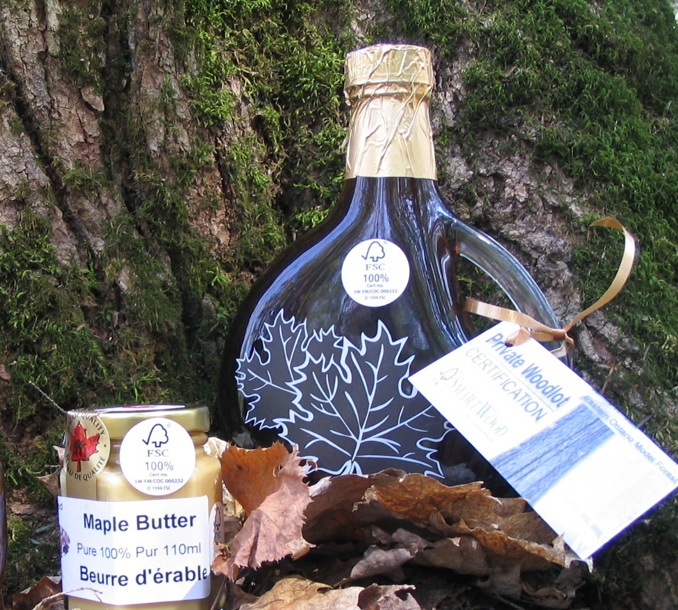
Not just wood from forests
Tree pulp can be made into paper and fabrics
Natural cork and rubber come from trees
Bamboo and rattan are grasses that can grow in forests
Maple syrup and nuts come from trees
©FSC Canada
Notes:
Wood isn’t the only product that can come from forests. Tree pulp can be made into paper and fabrics, natural cork, rubber and maple syrup come from trees and bamboo can grow in forests.

Slide 16
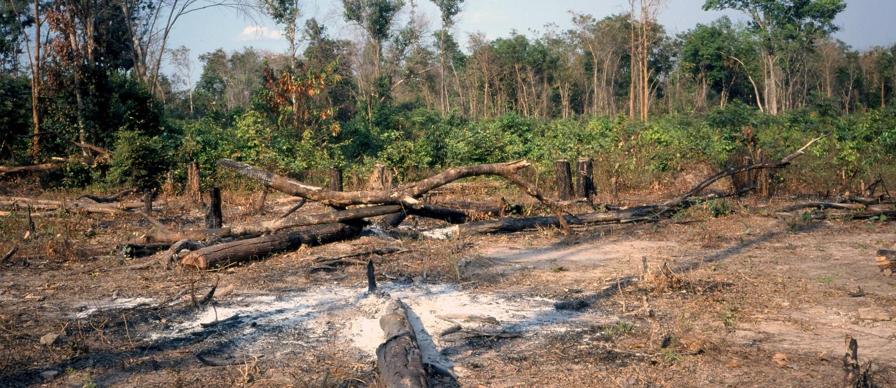
Deforestation
Forest in Cambodia being cleared to grow crops ©FAO / Masazaku Kashio
Notes:
But not all forests are the same. Some forests face being damaged or even destroyed.
When a forest is destroyed, the trees are burnt or cut and not replanted or allowed to regrow and the forest is lost – this is permanent deforestation. In the last 10,000 years the world has lost one third of its forests.

Slide 17
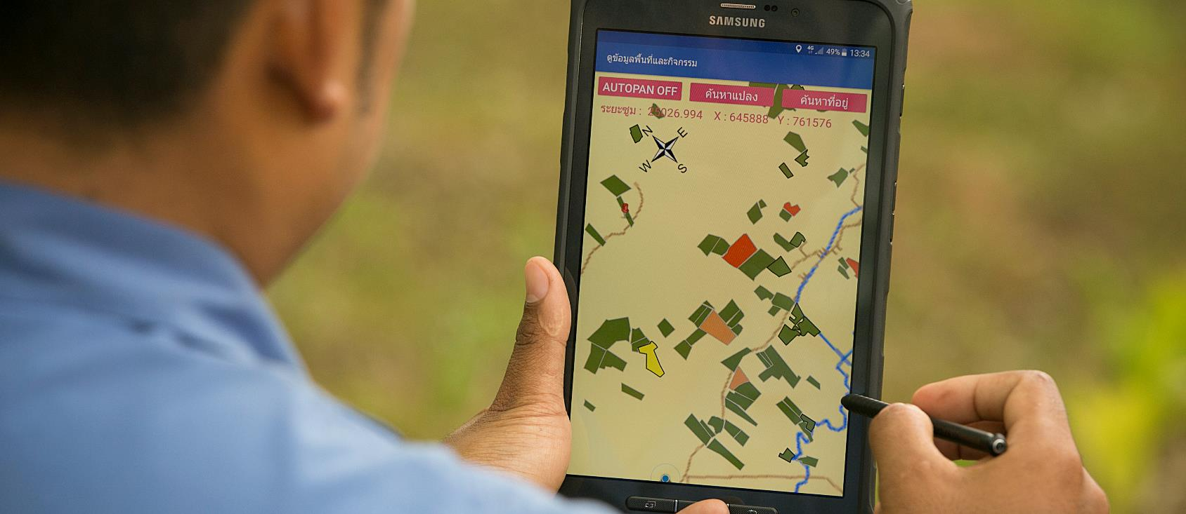
Auditing
©FSC / Mayank Bhavesh Soni
Notes:
FSC-certified forest managers and companies trading in forest-based products are checked to make sure they are doing the right things. Organisations called ‘certification bodies’ check that companies that own forests, or make products using materials from forests, meet the FSC rules. This is called auditing. Companies that pass the test can sell FSC-certified forest products.

Slide 18
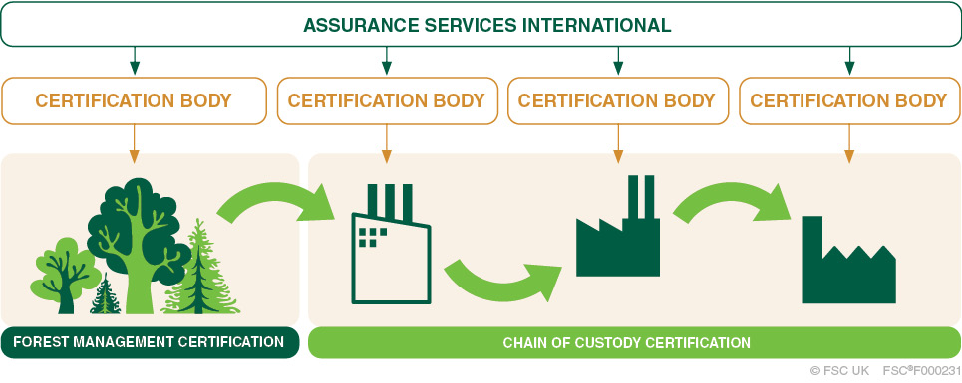
Certification
Notes:
There can be lots of different companies buying and selling materials and products between the forest where they are grown and the shop that sells a product made with those materials. If a product is FSC certified, every company in this chain must audited.

Slide 19
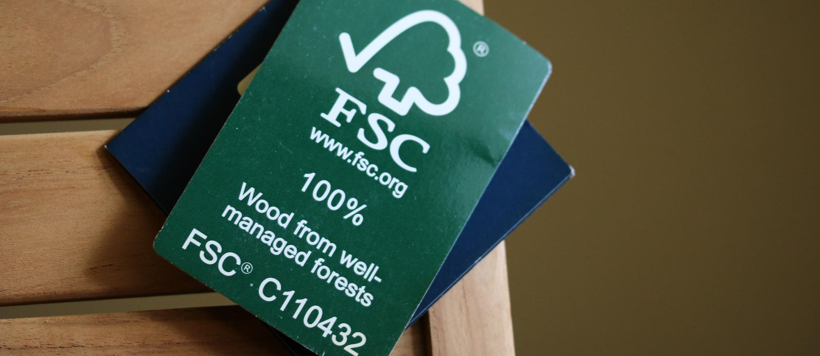
FSC labels
©FSC UK
Notes:
Products that meet FSC’s rules can have an FSC label put on them by companies that have passed and audit.
Look out for labels like this on wood, paper and other products next time you are shopping.

