Slide 1
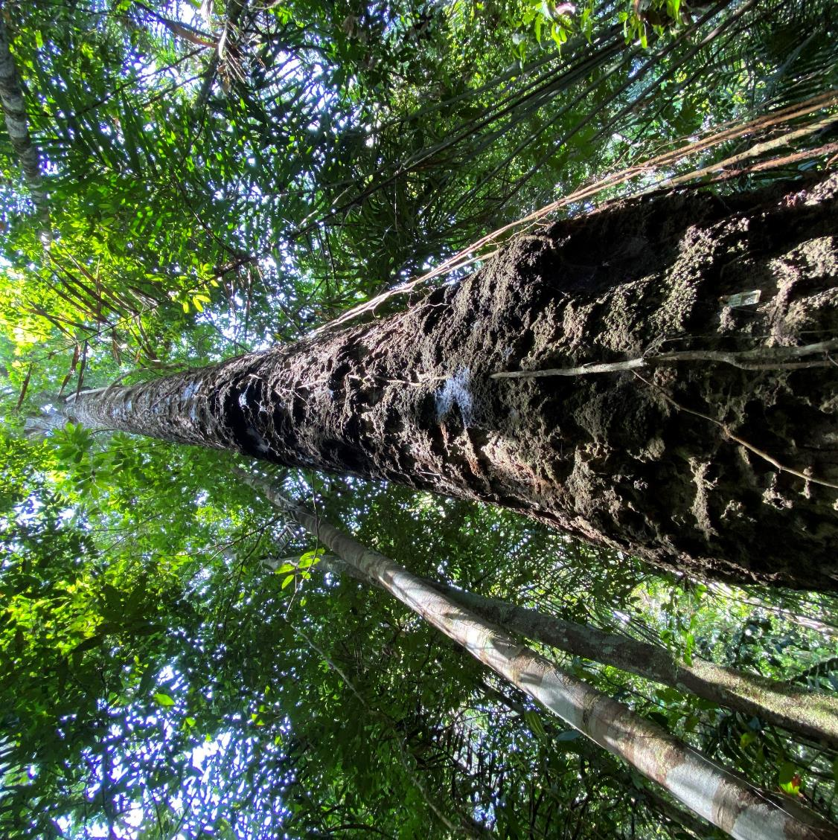
What comes from trees and forests?
How many product or materials can you think of that can come from trees or forests?
Notes:
How much do you know about the materials or products we use in our lives that come from forests? Can you name any?
Image credit: © FSC Latin America/ María Pía Rázuri

Slide 2

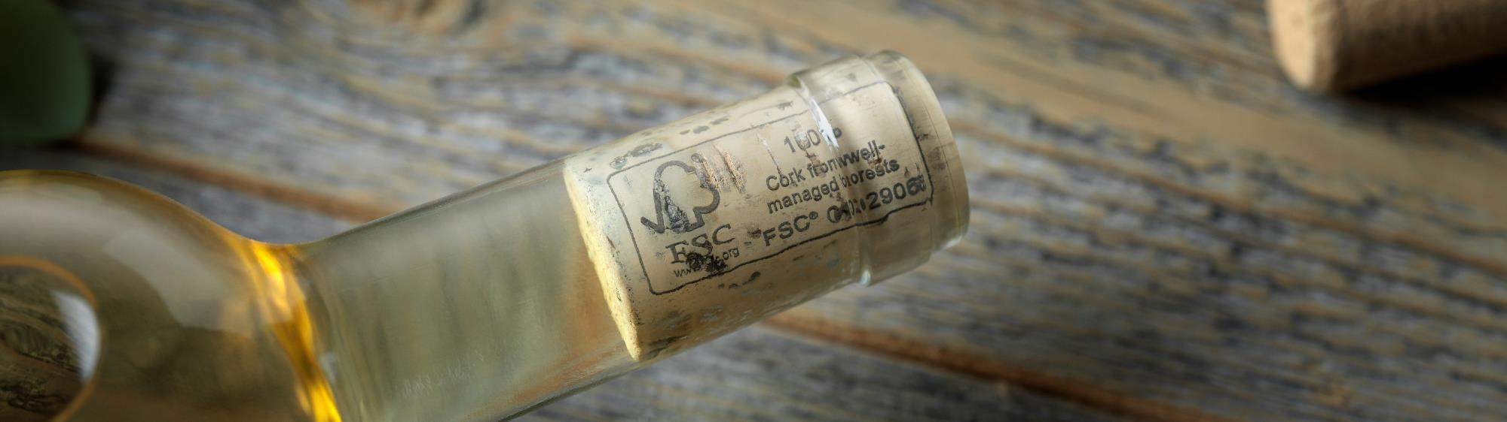
Rubber and cork?
If you said wood and paper – that’s right! These are the two main materials sourced from forests.
If you said rubber or cork, then you’re more knowledgeable than most young adults in the UK!
Notes:
Are you more knowledgeable that most young adults in the UK?
If you said that rubber or cork can come from forests, then you are!
Image credit: © FSC

Slide 3
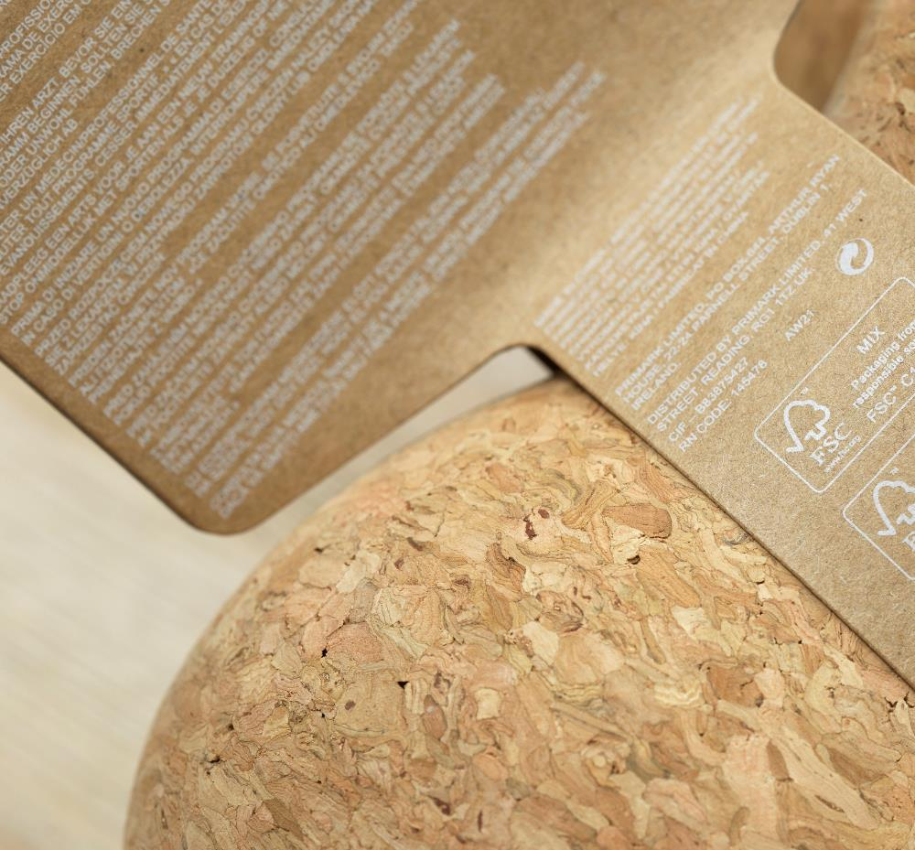
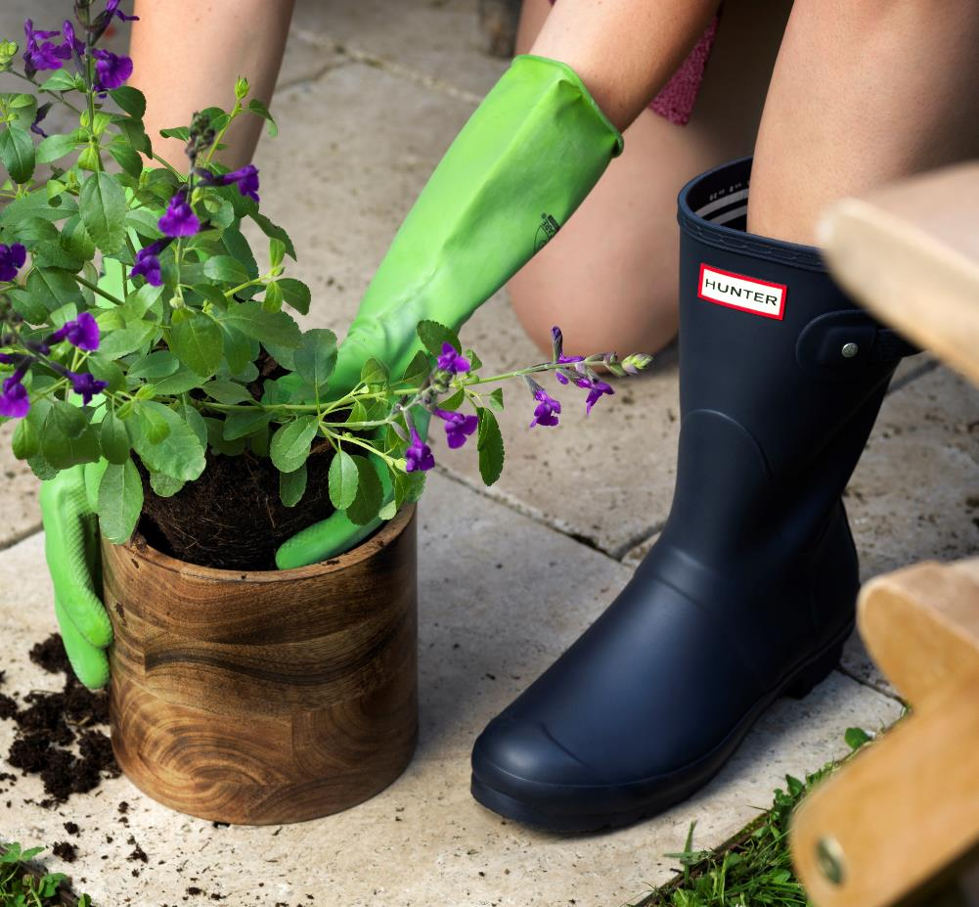
Older people tend to have better knowledge about the origins of cork and rubber
31%
30%
25%
34%
Gen Z
Millennials
Gen Z
Millennials
64%
78%
52%
81%
Gen X
Baby Boomers
Gen X
Baby Boomers
FSC UK Consumer Survey 2024
Q. Which of the following materials do you think can or do come from trees? (select all that apply)
Notes:
Have you heard the term ‘Gen Z’ before?
Gen Z is used to refer to people who were born between approximately 1997 and 2012. Millennials refers to those born between 1981 and 1996, Gen X to those born between 1965 and 1980 and Baby Boomers to those born between 1946 and 1964.
In a recent survey, those in Gen Z were least likely to know that cork and natural rubber come from trees.
Image credits: © FSC

Slide 4
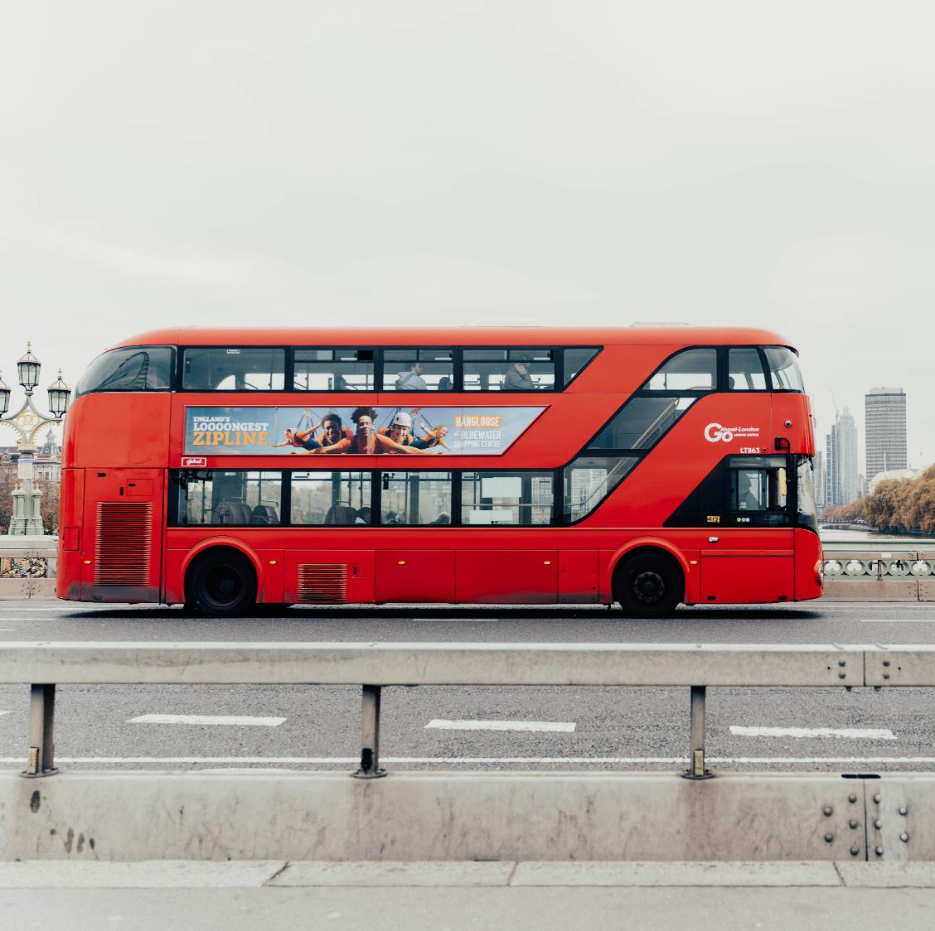
What about wood?
Trees usually have to grow to full maturity (between 25 and 100 years) before they can be cut down for wood.
There are thousands of different types of trees, meaning there are thousands of different types of wood.
Notes:
The UK uses around 17 million m3 of wood each year. That's roughly the same as 170,000 double-decker buses!
Trees normally grow for a long time – up to 100 years or more – before they are cut down for wood.
There are thousands of different types of trees and thousands of different types of wood. Different types of wood are good to use for different things.
Image credit: Unsplash / Anna Claire Schellenberg

Slide 5
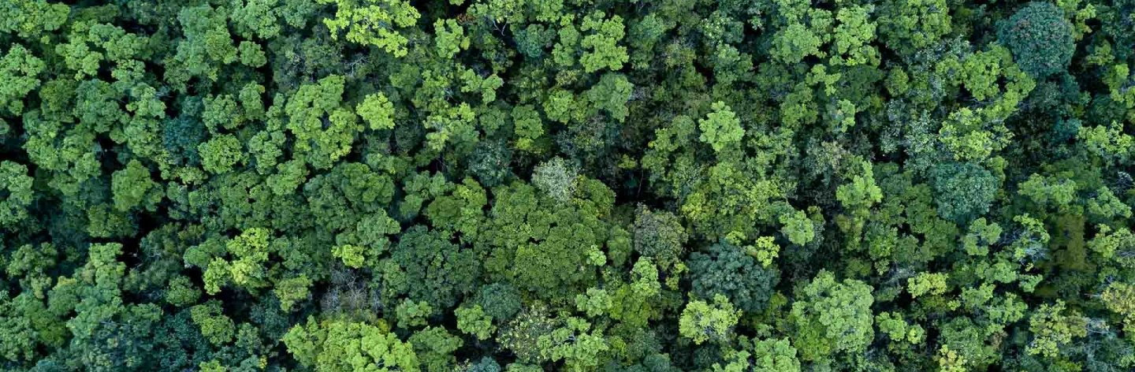
Hardwood or softwood?
In general, hardwood comes from deciduous trees which lose their leaves annually. E.g.: Oak, Ash, Beech, Mahogany, Teak
Softwood comes from conifers, which usually remain evergreen. The trees from which hardwood is obtained tend to be slower growing, meaning the wood is usually denser. E.g.: Pine, Cedar, Spruce, Fir
Notes:
Do you know the difference between a hardwood and a softwood?
In general, hardwood comes from deciduous trees which lose their leaves annually. Softwood comes from conifers, which usually remain evergreen.
Hardwoods are usually, but not always, heavier, and often darker in colour.

Slide 6
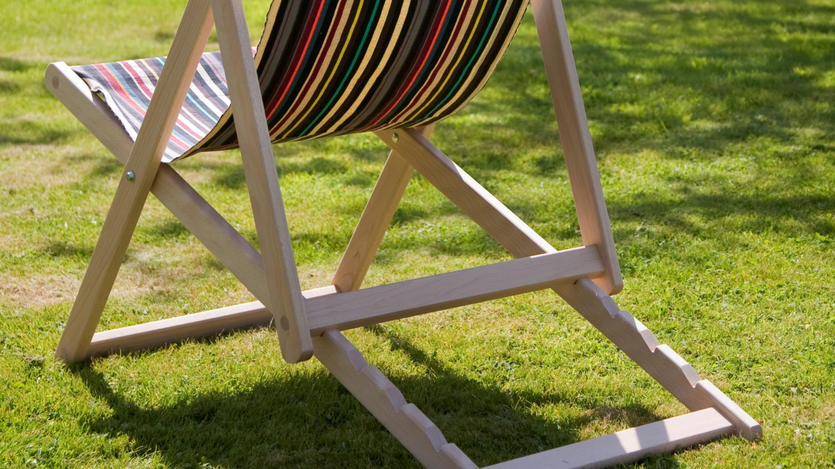
Notes:
What kind of wood is this deckchair made from? Is it a hardwood or a softwood? How can you tell? What else could you help you to tell?
Without being able to touch the product itself, it’s not easy to tell if it’s made of a softwood or a hardwood – we might guess at it being a softwood due to the light colour, but could equally be a pale-coloured hardwood like beech or ash. Having an idea of the weight of the chain might help us to decide. But there are exceptions – did you know that the lightest and softest wood in the world – balsa wood – is actually a hardwood?
Image: © Hen and Hammock

Slide 7
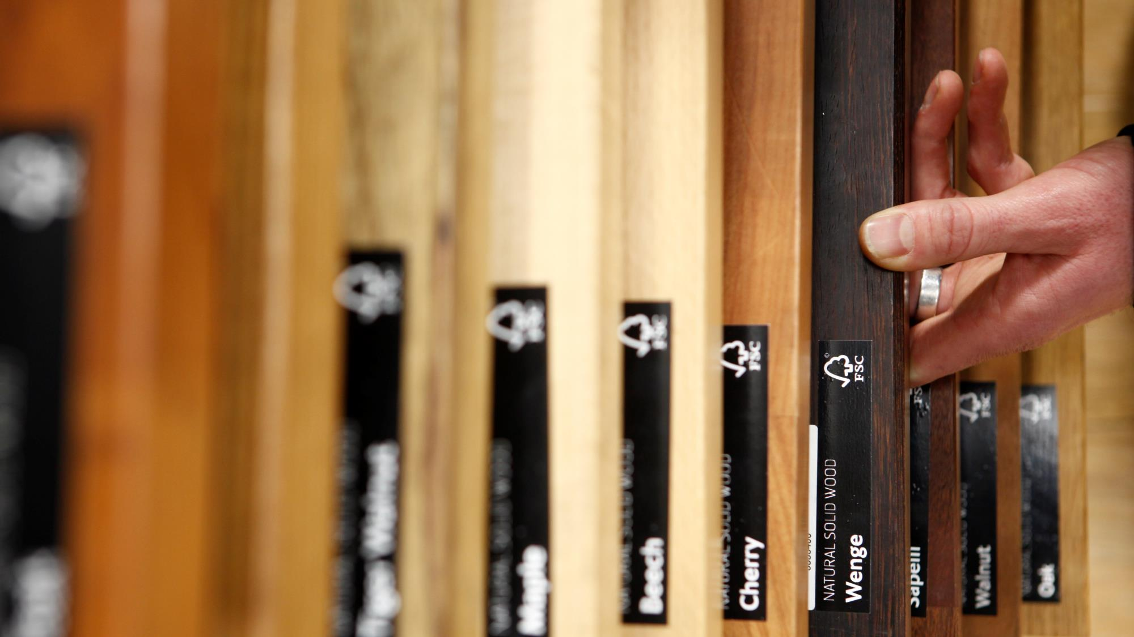
Notes:
Different species of tree produce different colours of timber with different properties. Some are very durable, making them good for use outside, and some are very strong, making them good for use in construction. Different timbers are sourced from different kinds or trees and forests around the world.
Image credit: © WWF UK / Benjamin Ealovega

Slide 8

Notes:
Could the pencil and the notebook be made from some of the same materials? Why?
The pencil is made from wood – probably a softwood. Paper is made from cellulose fibre. Cellulose is an important structural component of the primary cell wall of green plants, such as trees. Paper can be made from cellulose from any source but most paper is made from cellulose fibre from trees. Trees are made into wood pulp at a pulp mill. Coniferous trees, producing softwoods, are usually preferred because the cellulose fibers in the pulp of these species are longer, and therefore make stronger paper. It’s likely that most paper will contain a mix of wood species.
Image credit: © Unsplash / Jan Kahanek

Slide 9
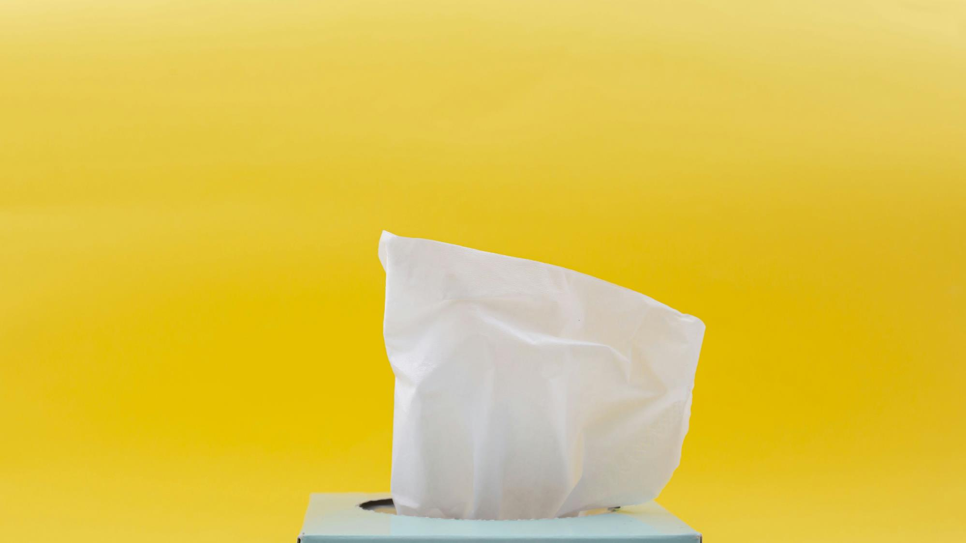
Notes:
Like paper, tissue, like you use to blow your nose or when you use the toilet, is made from cellulose fibres. Most toilet paper and tissue products are made using cellulose from trees. It may not look much like wood, but this is a product that has taken a long time to refine. The first recorded use of toilet paper is from 6th century China, the first perforated toilet paper rolls were introduced in 1890, but it wasn’t until that 1930 that toilet paper was finally manufactured “splinter-free”!
Image credit: © Unsplash / Diana Polekhina

Slide 10
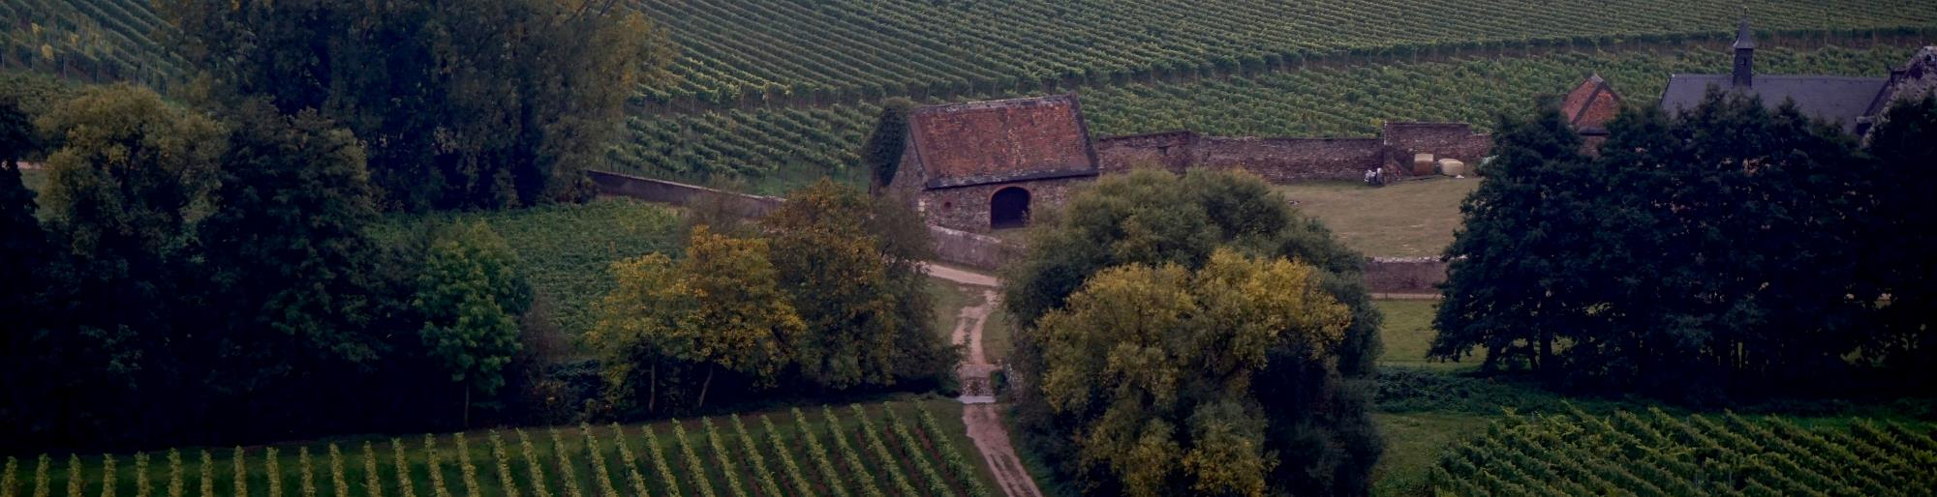
Corrugation:
VERB
to fold or be folded into alternate furrows and ridges
ADJECTIVE
folded into furrows and ridges; wrinkled
Notes:
We’re going to talk about carboard next – an important term, which describes a type of carboard, is corrugated. Corrugated cardboard is made using paper that is folded into ridges.
Image credit: © Unplash / Beth Macdonald

Slide 11
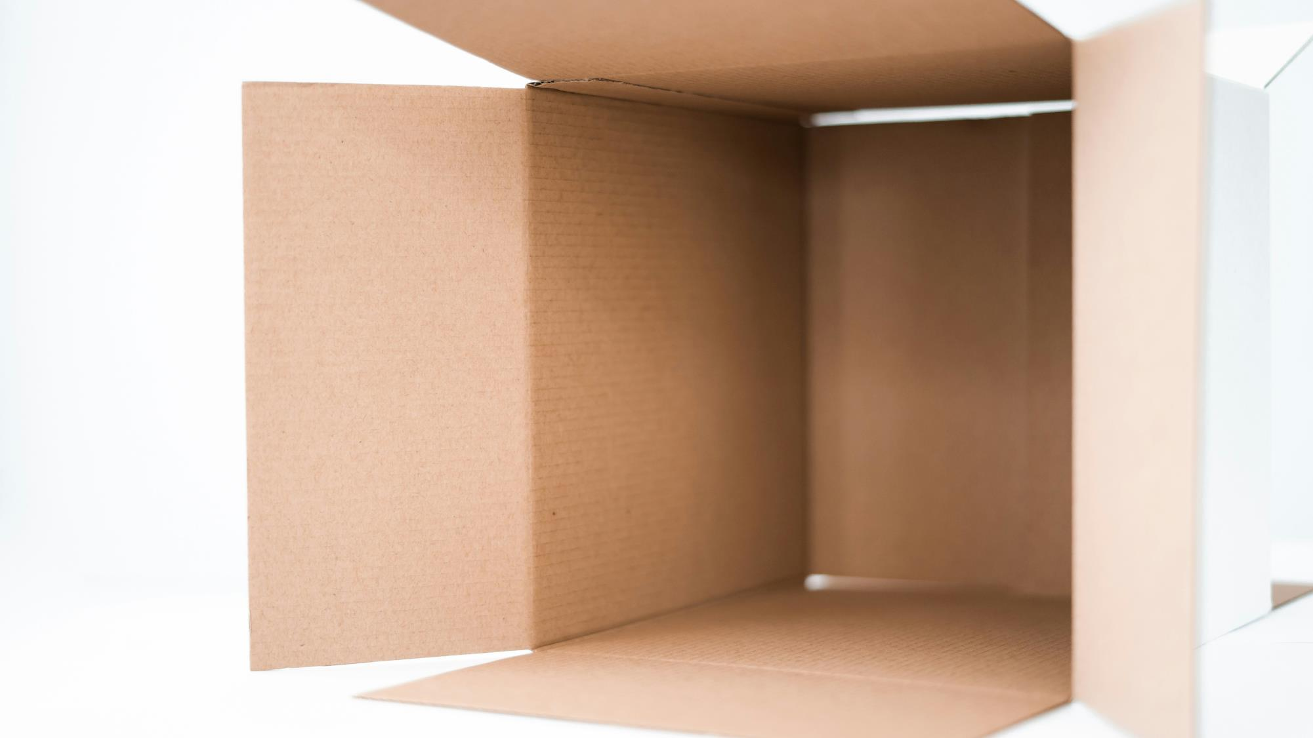
Notes:
Cardboard in a general term used to describe both paper over a certain thickness or weight, which is more properly called paperboard, and corrugated fibreboard, such as has been used to make this box. Using corrugated sheet cardboard provides added rigidity and cushioning and is therefore a popular choice for delivery packaging.
Can you think of any other examples of cardboard packaging? Do they use corrugation?
Is this box made from recycled paper? How can you tell? (just because it is brown, doesn’t mean it’s recycled it just means it isn’t bleached)
Image credit: © Unsplash / Kelli Mcclintock

Slide 12
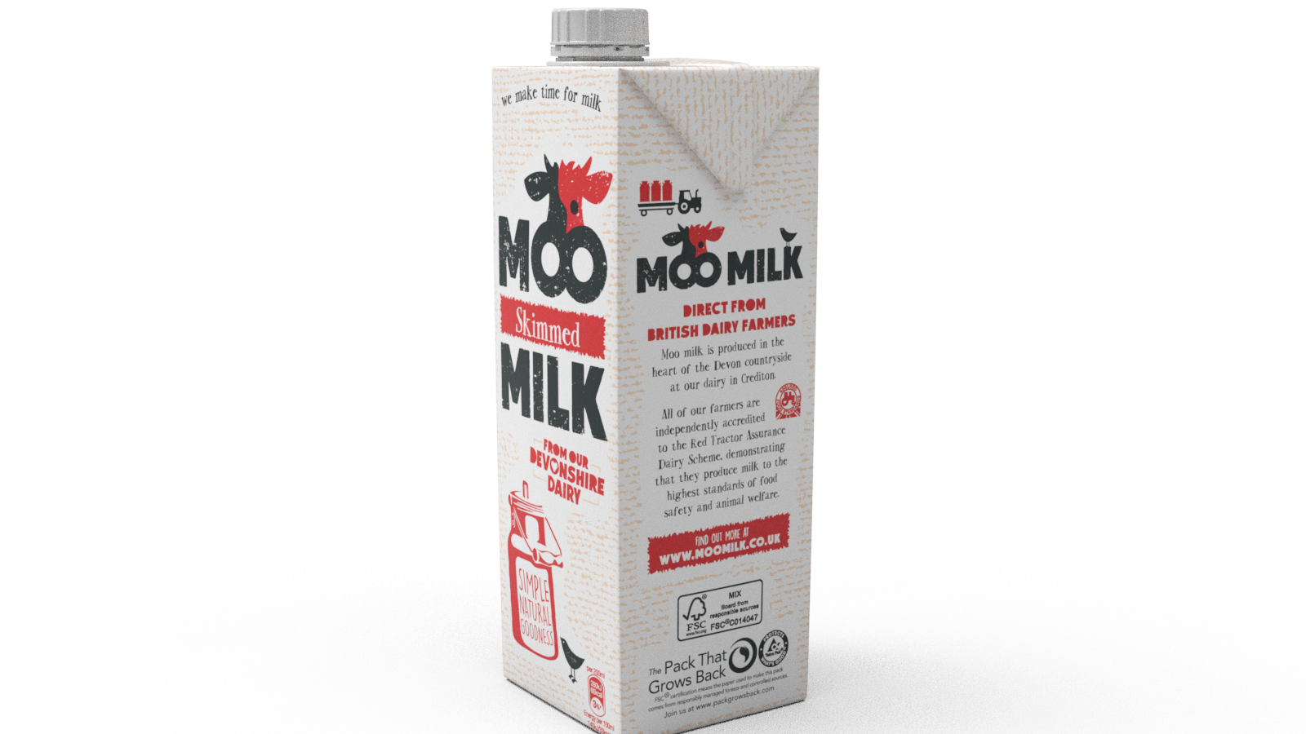
Notes:
How many different materials if this carton made from? Which material has been used for 70% of this carton?
An average Tetra Pak® carton is made of about 70% paperboard, 25% plastic and 5% aluminium to protect its contents – cartons like these are recyclable where adequate collection, sorting and recycling systems are in place.
Image credit: © Tetra Pak

Slide 13
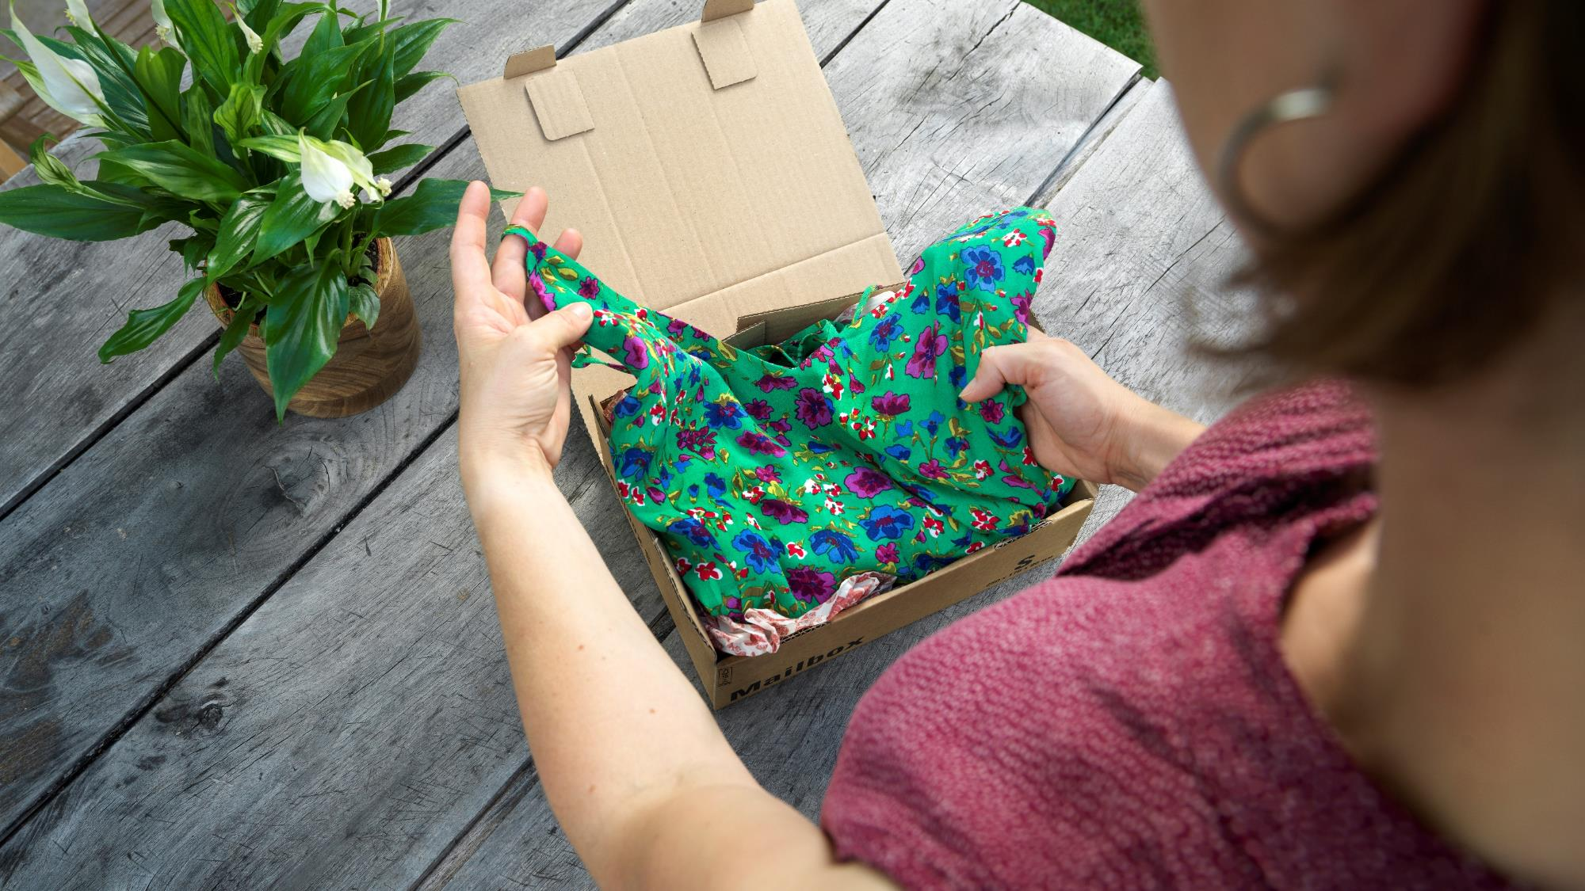
Notes:
What is this new clothing made from? How could you find out?
What are you wearing? Can you or a friend read the care label on one or more of the items of clothing you’re wearing? Does it tell you what material it is made from? Is it made from more than one material? Does the label contain any other information in relation to the materials from which it is made? Is the clothing made from a natural material? Can you think of any other examples of natural materials used to make clothes?
This clothing is made from viscose, which is a man-made cellulosic fibre. Like paper, it can be made with wood pulp from trees.
Image credit: © FSC

Slide 14
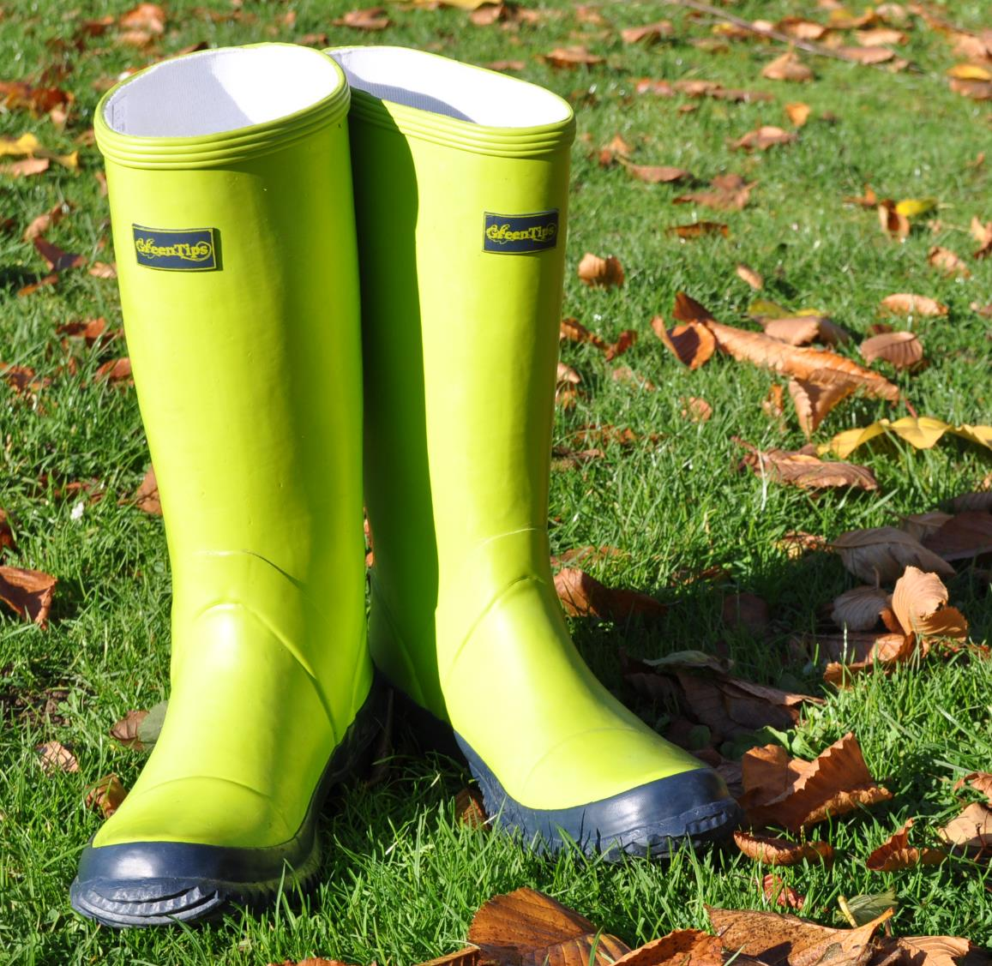
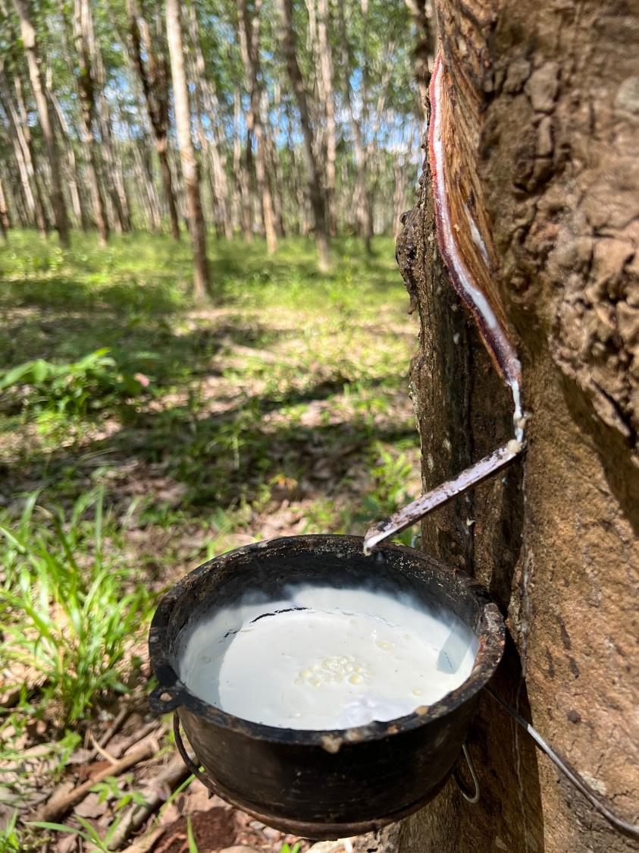
Notes:
Are these wellington boots made from plastic?
These boots are made mainly from natural rubber. Natural rubber is made from the liquid latex that is harvested from rubber trees. The latex is harvested by slicing a groove into the bark of the tree and peeling back the bark. This process does not kill the tree, which can go on to producing latex for many years. Most rubber is taken from trees grown in Asia.
Image credits: Wellington boots © FSC UK; Rubber tapping © FSC / Vanessa Cheung

Slide 15
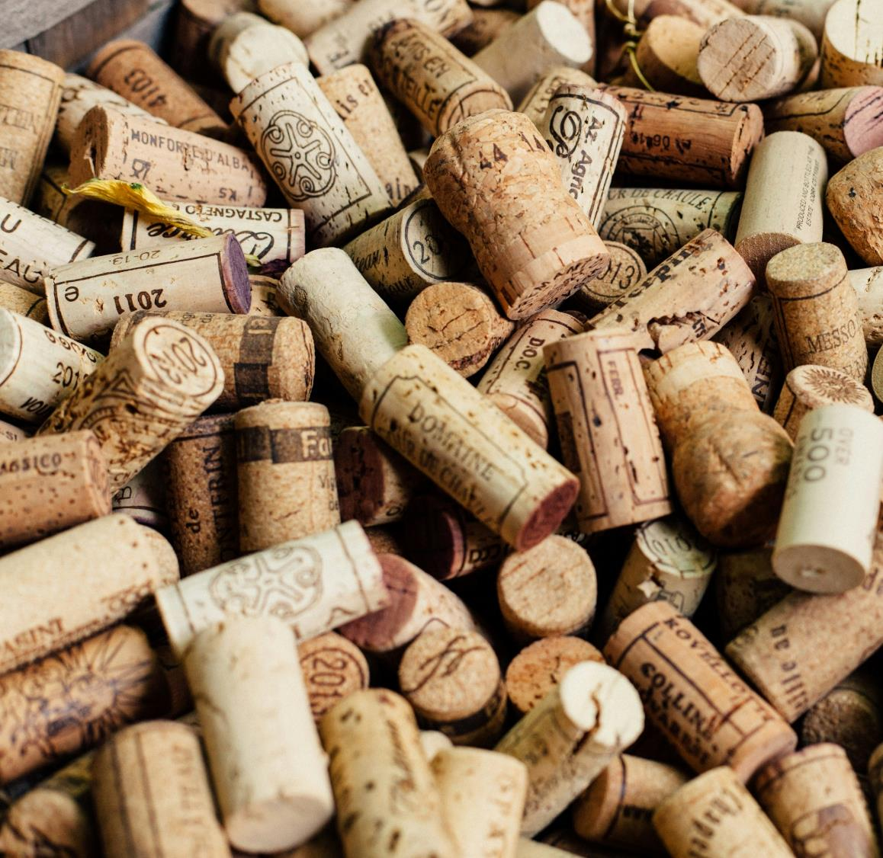
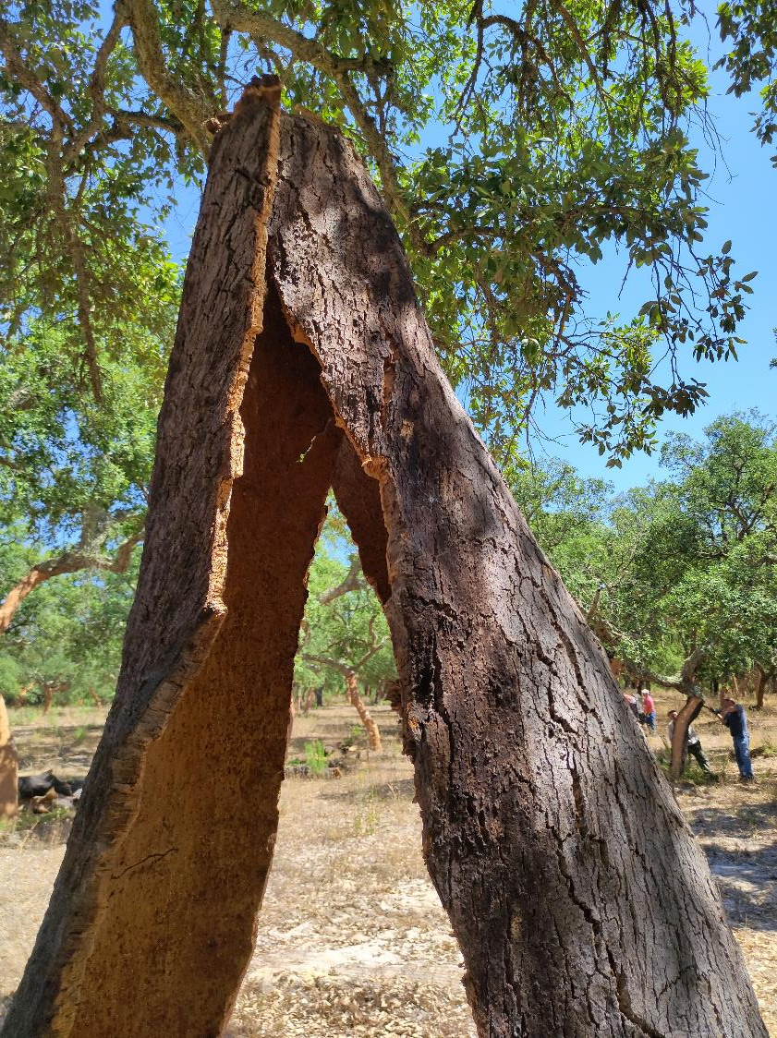
Notes:
Cork comes from trees but, like rubber, harvesting it does not kill the tree. These corks are made from the bark of the cork oak. Most cork comes from Portugal.
Apart from for closing wine and champagne, can you think of any other products made from cork?
Image credits: Wine corks © Unsplash / Elisha Terada; Cork bark © FSC Portugal

Slide 16
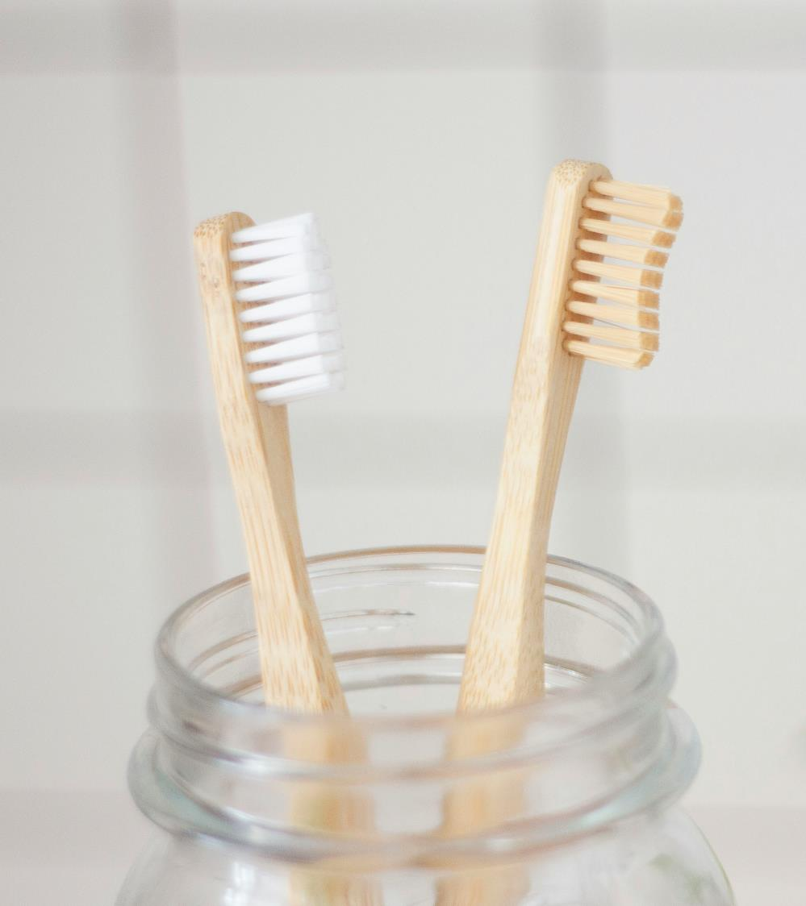
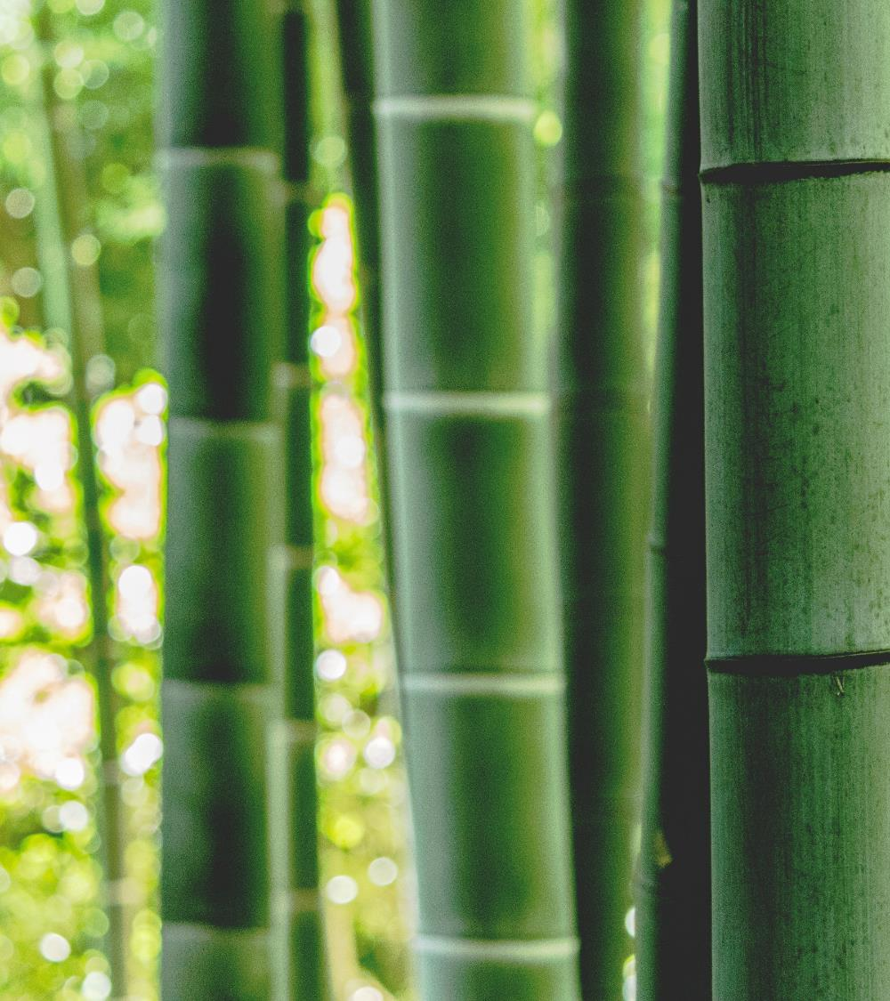
Notes:
What are these toothbrushes made from?
To try to reduce plastic, toothbrushes made from wood and bamboo are increasingly available.
Bamboo is not a tree, it is categorised as a grass, but it can grow in forests. It’s one of the fastest growing plants in the world, some species can grow 1.5 inches in an hour! Most bamboo is grown in Asia. China is home to the most different kinds of bamboo species of anywhere in the world.
Can you think of any other products made of bamboo?
Image credits: Bamboo toothbrushes © Unsplash / Superkitina; Bamboo forest © FSC China / Feiyue Liu

Slide 17
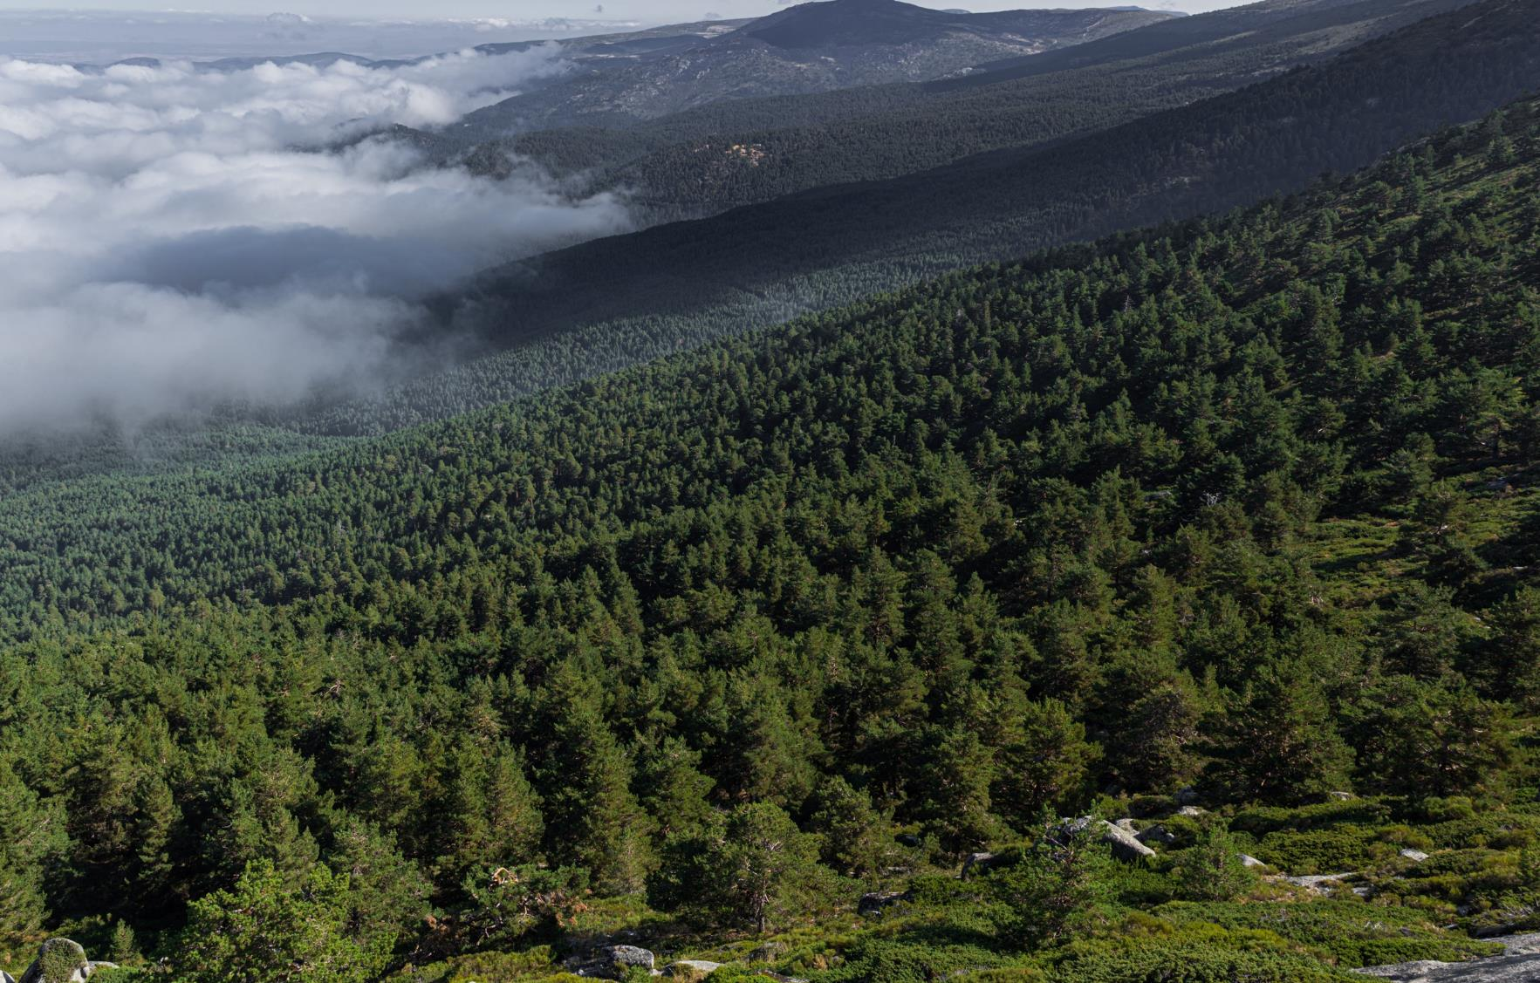
Is it a good idea
To use forest-based products?
Notes:
We probably see and use forest-based products every day of our lives.
Given that some forests are threatened by deforestation, and that deforestation contributes to climate change, should we be using materials from forests? Why is it a good idea? Why might it be a bad idea?
If we don’t use materials from forests, which materials would we use? Is it better to use forest-products in place of plastic? What might be the advantages or disadvantages?
Image credit: © FSC Spain / Fernando de Antonio

Slide 18
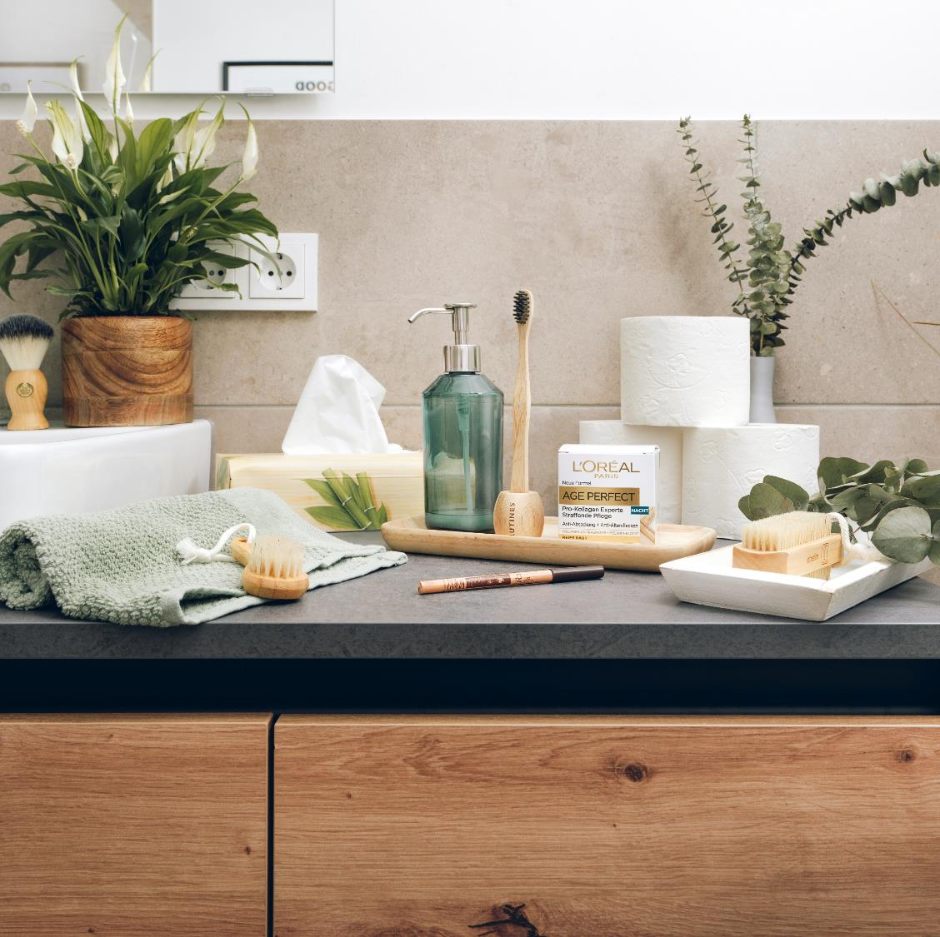
Benefits of forest-based products
Renewable (can be grown again and again)
Recyclable
Wood uses less energy to make than concrete, cement, bricks or steel
Can replace plastic (which is made from oil) in lots of situations
Notes:
Wood is one of the oldest building materials in existence. Humans have used it to make tools, buildings and more for thousands of years. Because wood and other forest-based products come from a natural source, they can have many benefits.
Image credit: © FSC

Slide 19
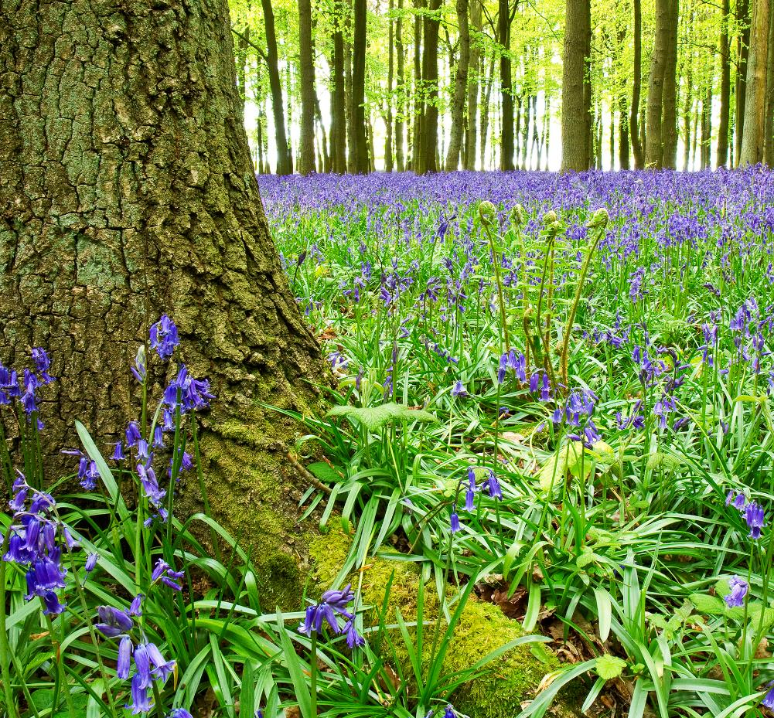
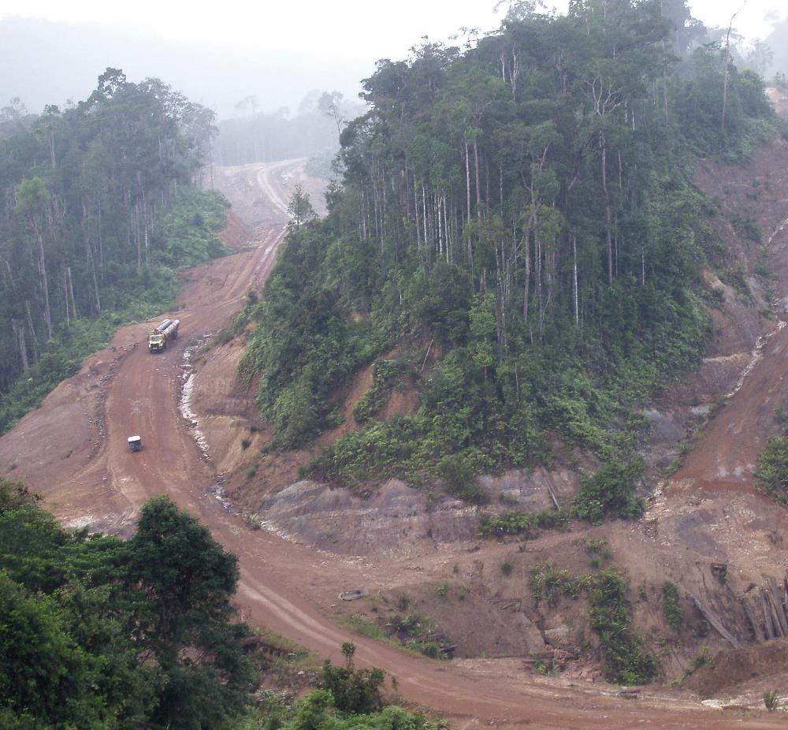
But how do you know where your forest-based products are from?
Notes:
But forest-products are really only a good thing if they are harvested responsibly, from forests that are properly managed, and where trees are replanted or allowed to regenerate. Do you know what kinds of forests the forest-products in your house (or even your pencil case!) come from?
Image credits: © FSC UK / Yi Sun; No credit

Slide 20
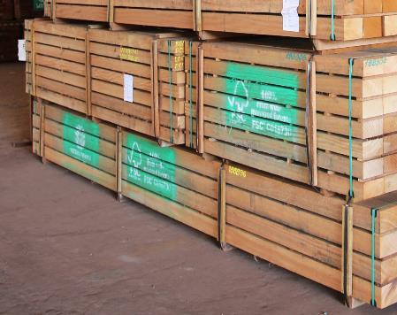
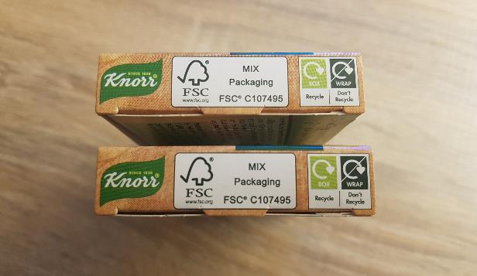
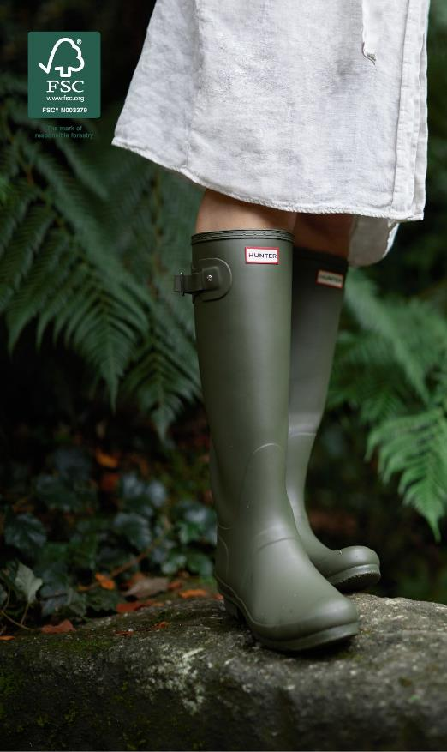
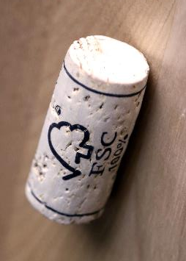
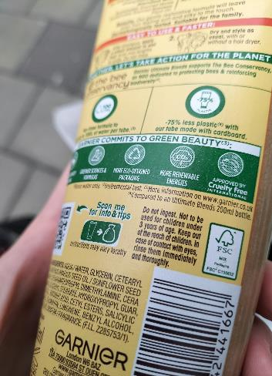

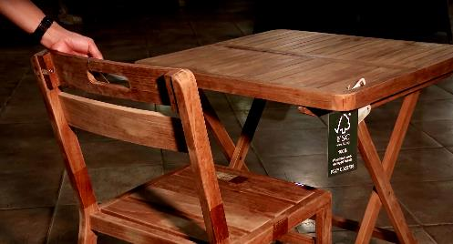
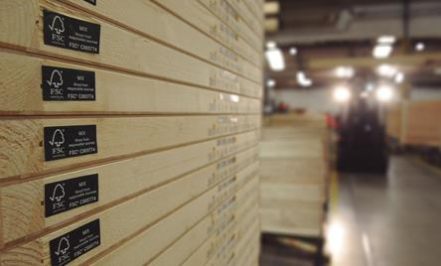
We rely on forests to provide materials for daily life
When responsibly sourced, these materials can be renewable and keep carbon locked up.
Notes:
Certification labels are used to show that products or packaging meet certain standards.
The Forest Stewardship Council, also known as FSC, is an international organisation dedicated to promoting the responsible management of the world’s forests. FSC has developed a system of forest certification that allows consumers to identify wood and forest-based products that support responsible forestry. These forests must be managed with consideration for the environment, the wildlife and the people who live and work in them.
Have you seen the FSC label on any packaging or products?
How important is it that forests are managed sustainably?

Slide 21
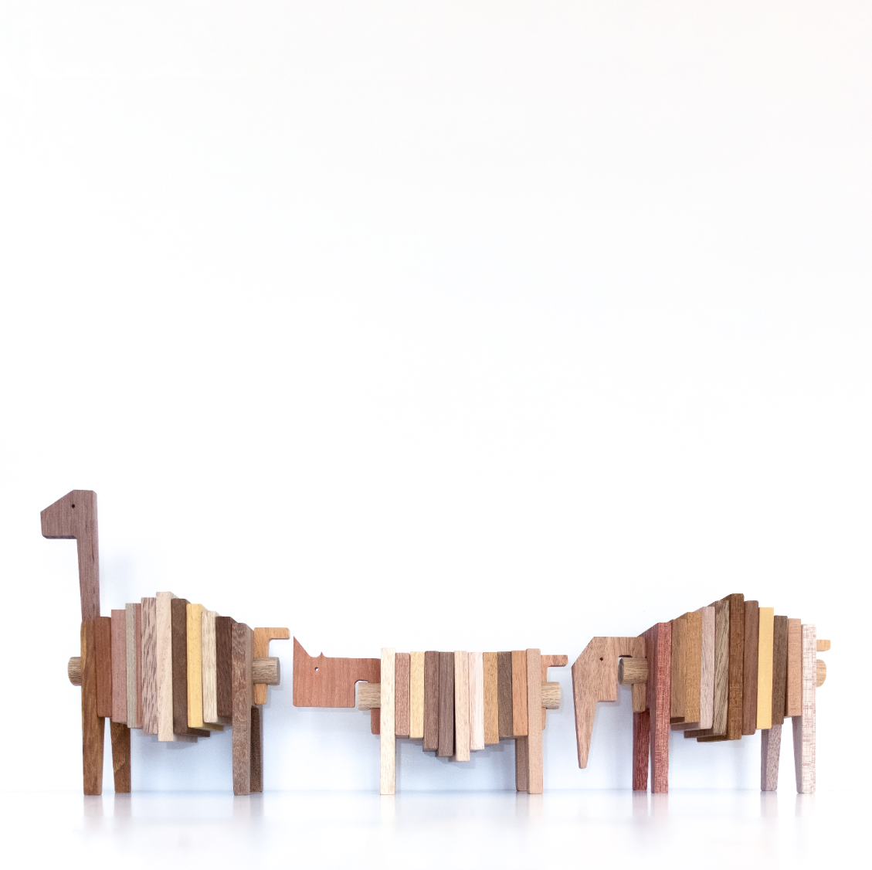
Lesser-known timber species
The demand for tropical timber in the UK and Europe is very high, with most of it focusing on a few well-known species. Some are so popular that high quality timber in these species can be difficult to find.
Increasingly, companies are considering using lesser-known species in place of the more common woods.
Notes:
There are more than 60,000 species of timber around the world, but only a fraction of these are bought and sold in substantial quantities around the world.
Some of the most popular species in the world are under threat of extinction in the wild, and yet many lesser-known timber species are under used.
FSC has made an online database of lesser-known timber species to support those using tropical timber to consider alternative species.
Image credit: FSC Denmark

Slide 22
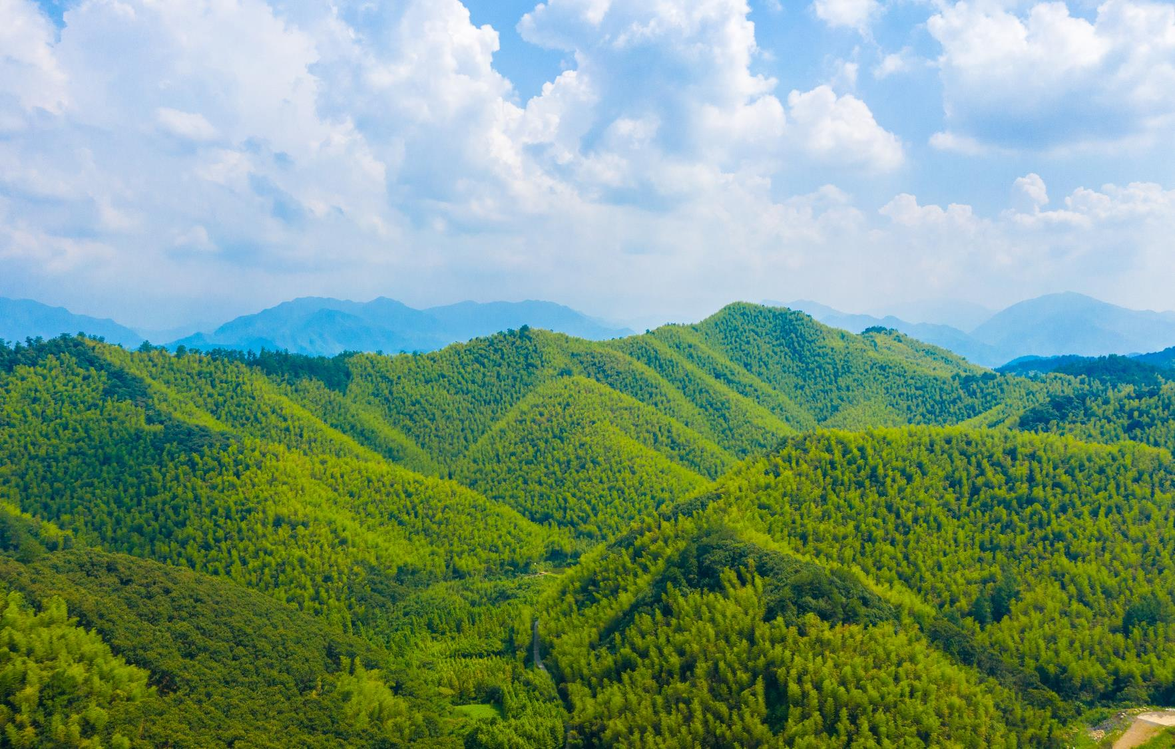
Activity:
Design a product
FSC-certified bamboo plantation in Hengxiwu village
© FSC China / Feiyue Liu
Notes:
Design a product using forest-based materials, including at least one species or wood and one other forest-based material, and explain your choices.
Things to think about:
Who/what is it for?
What physical properties do you need the materials to have? (rigid, flexible, beautiful, strong, durable, light etc)
Which species of wood will you choose and why?
Can you source the materials from the UK or will you need to source them from another country or area of the world? Which country or area?
How will you make sure that the materials you use are sourced responsibly?
Are there any alternative materials or species you could use?
Is the product practical/usable, innovative, and sustainable?
Image credit: © FSC China / Feiyue Liu

Slide 23
